Slide 1
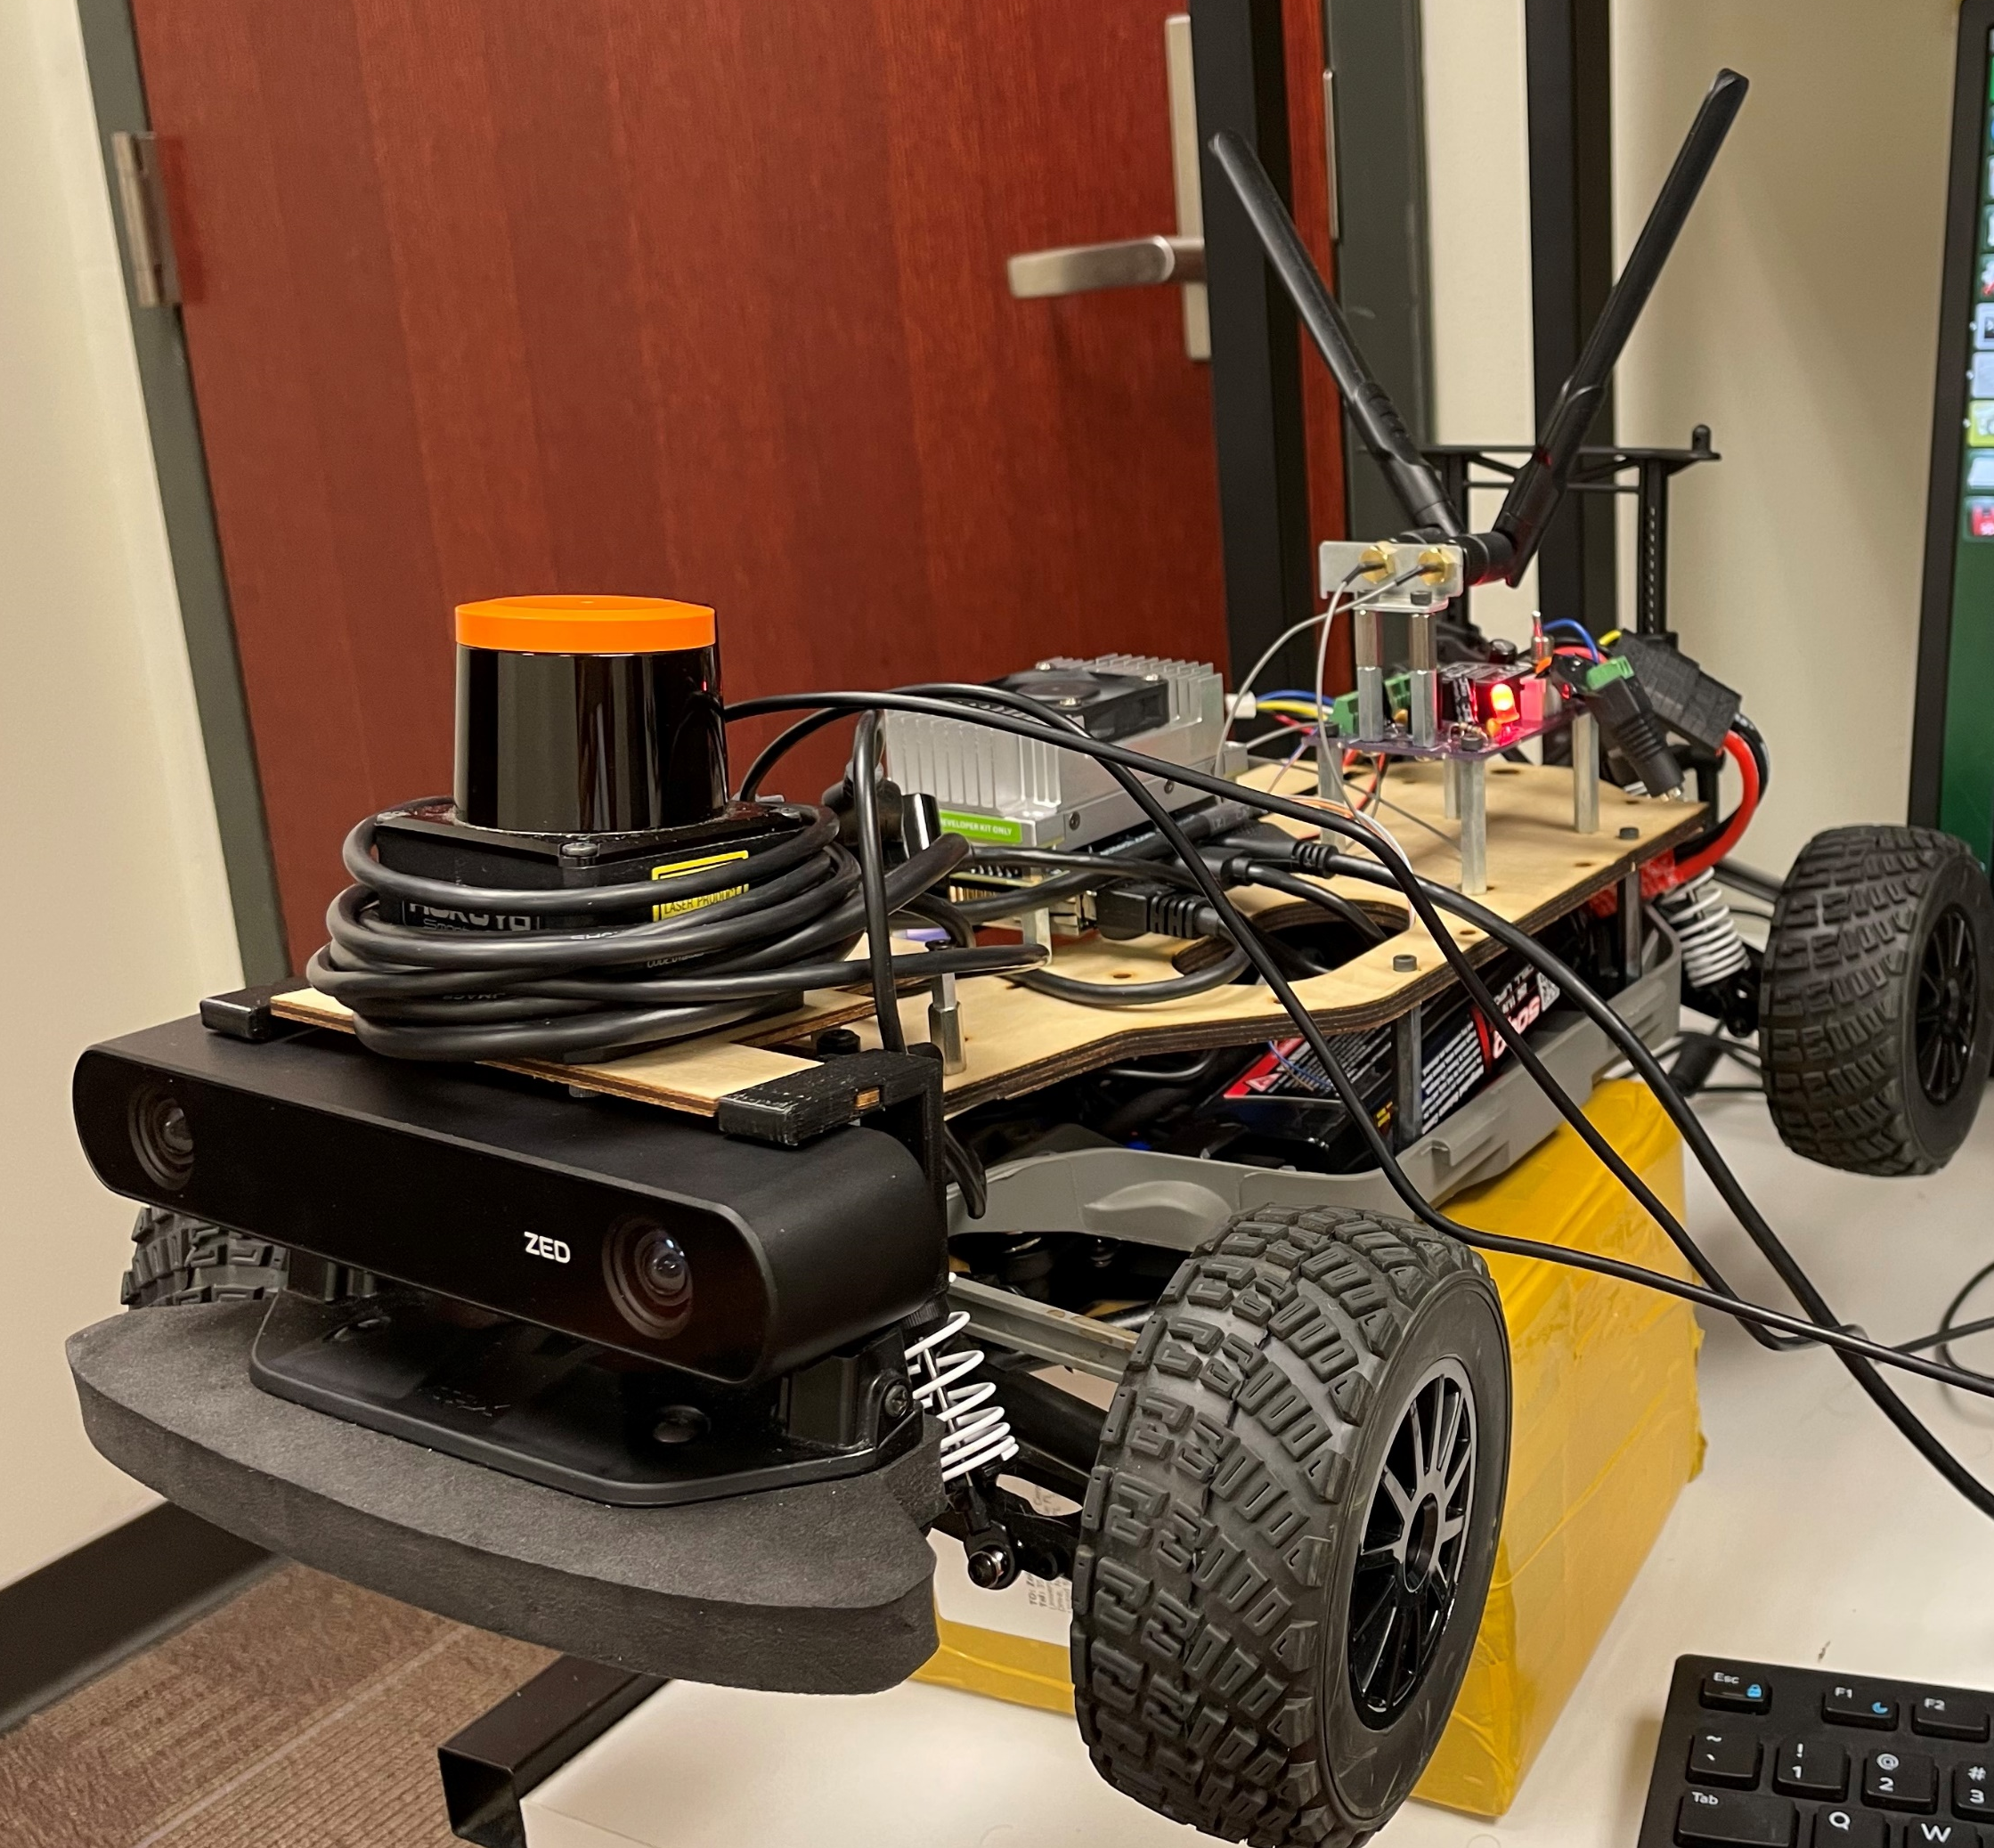
Perception for F1-Tenth autonomous car
- By Krishna Nuthalapati

Slide 2
Goals:
To detect the objects in proximity and estimate the depth.
Use Simultaneous Localization And Mapping (SLAM) techniques to create a 3D map.
Use that map to understand the surroundings and navigate through it.
All of this is to be done fast enough i.e in real-time on a device with limited computation power.

Slide 3
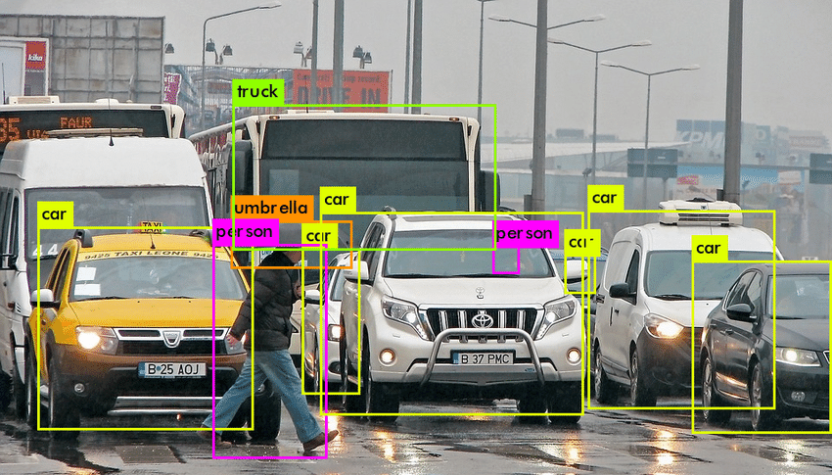
Object detection
Object detection and localization using DNN.

Slide 4
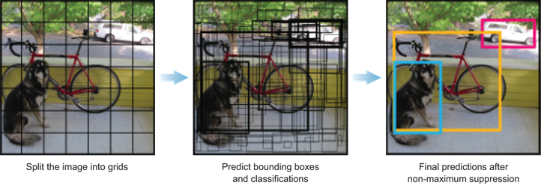
Object detection
YOLO – You Only Look Once

Slide 5
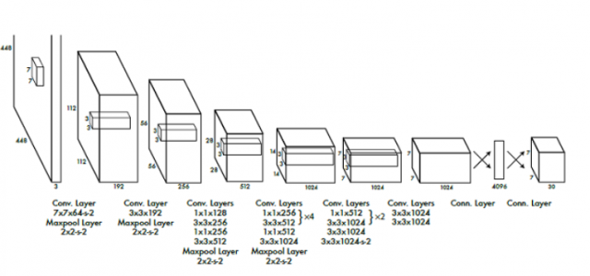
Object detection
YOLOv1 architecture

Slide 6

Object detection
YOLOv1 architecture
Image convolution

Slide 7
Object detection
YOLOv1 architecture
Final layer

Slide 8

Object detection
YOLOv1 architecture

Slide 9
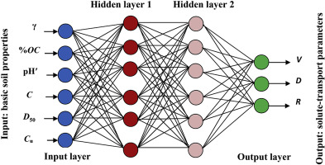
Object detection
YOLOv1 architecture
Basic neural network

Slide 10
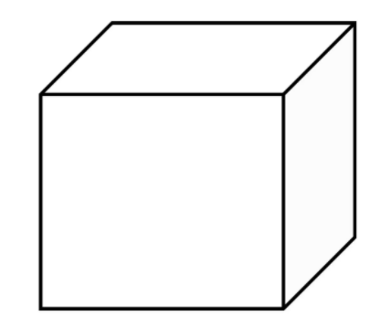
Object detection
YOLOv1 architecture
p(c) - Class predictions
C
x
y
w
h
7
7
30
Final layer

Slide 11
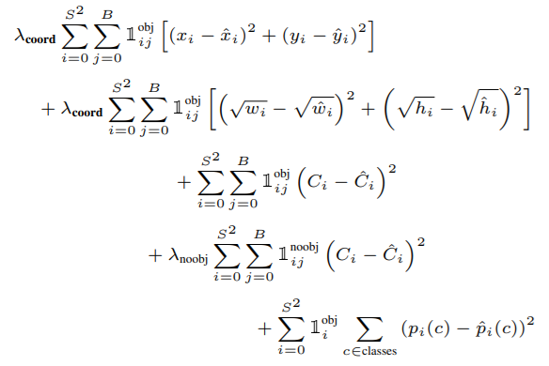
Object detection
YOLOv1 Loss function
p(c) - class predictions
C
x
y
w
h

Slide 12

Object detection
Performance metrics – mean Average Precision (mAP) is most used evaluation metric in object detection.
mAP is determined using Intersection Of Union (IOU) and Non-Max Suppression (NMS).

Slide 13
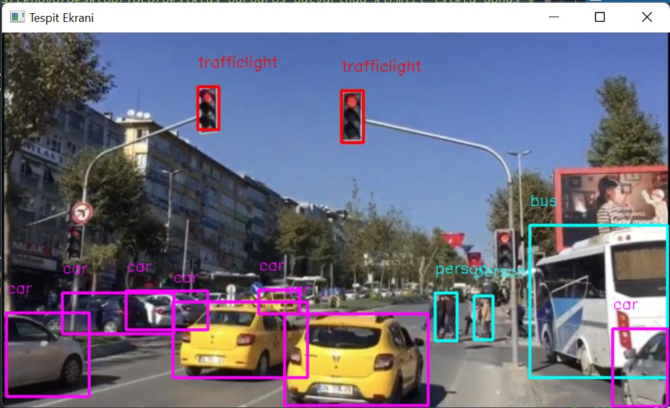
Object detection
But YOLOv1 struggles detecting smaller objects.

Slide 14
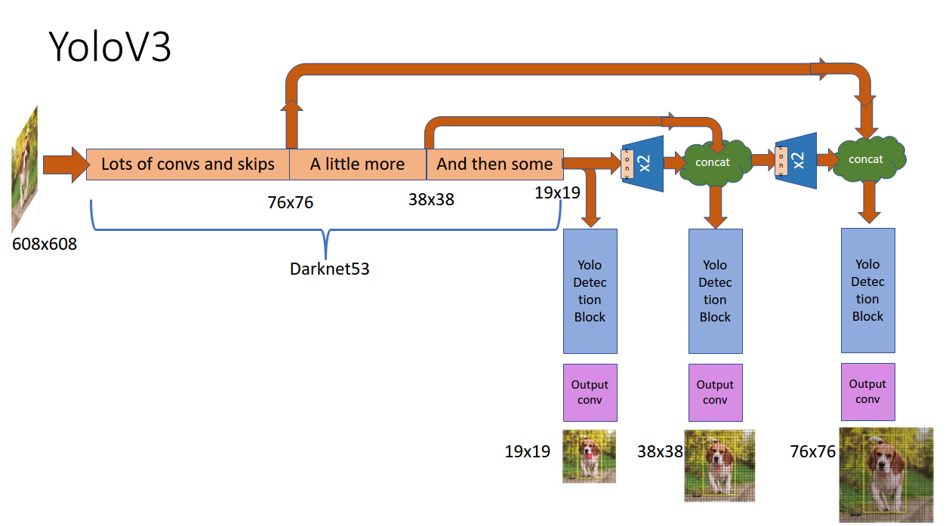
Object detection
So, switching over to YOLOv3 should do the job.

Slide 15
Making it real-time
Zero copy data transport is key to faster processing of image data.
message
Process 1
Process 2
Common memory
space
Publisher
Subscriber
C++
C++ / Python
NODE 1
ROS NODES
NODE 2

Slide 16
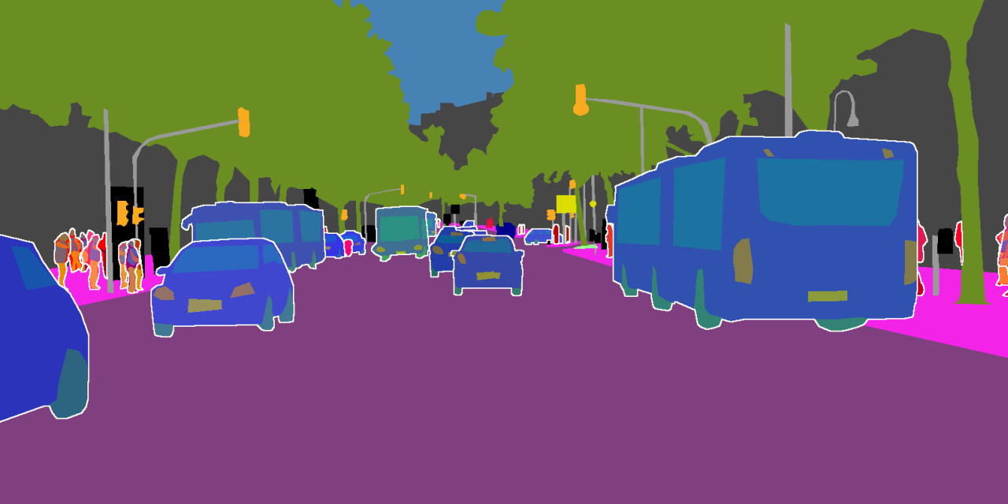
Image segmentation
Why panoptic segmentation is needed?

Slide 17
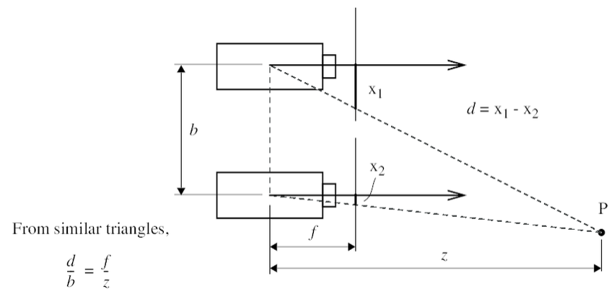
Depth estimation
Depth can be estimated using the cameras without any other sensors. This works based on the triangulation method shown below,

Slide 18
3D Map creation
3D point cloud can be obtained by estimating the depth of all the pixels containing in an image.
Once we have a point cloud, we combine this with the panoptic segmented image to obtain an initial understanding of the points in the point cloud.
Now, the depth estimation and panoptic segmentation will be noisy, meaning that at every instant there is a possibility of change.
So, we need to filter out the noise which can be done using optimal estimation methods like Kalman filter.

Slide 19
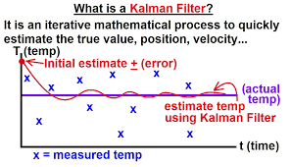
3D Map creation
Kalman filters

Slide 20
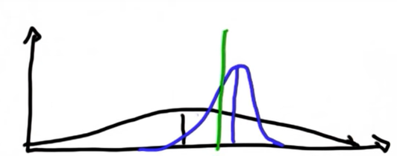
3D Map creation
Kalman filters
resulting gaussian

Slide 21
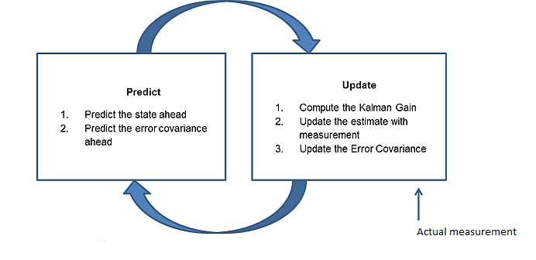
3D Map creation
Kalman filters

Slide 22
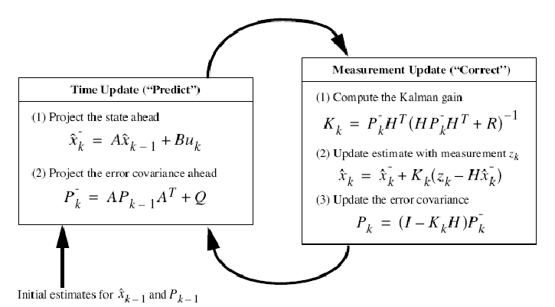
3D Map creation
Kalman filters

Slide 23
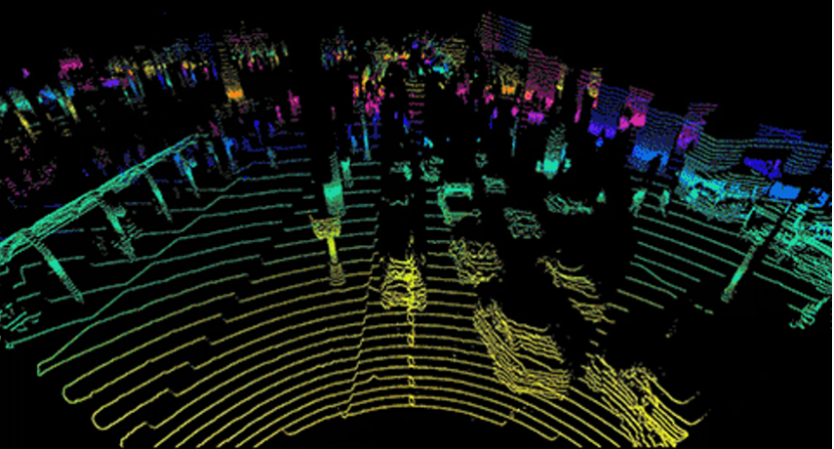
3D Map creation

Slide 24
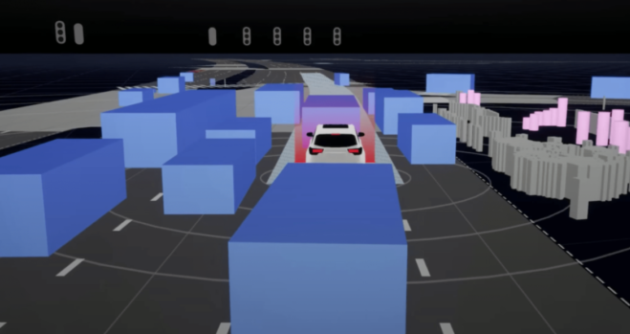
3D Map creation

Slide 25
Deep learning limitations
Deep learning is good in interpolating but not extrapolating.
If it must perform well in million different situations it has to be trained using million similar situations.
They are data hungry networks.

Slide 26
Thank you!

